Slide 1

Department of Computer Science and Engineering
Course name : Data Science
Course code : U23AD491
Title of the project : Student Dropout Prediction System

Slide 2
Class / Section / Semester | : | III CSE / A / V
Batch | : | 2024-2028
Project Review | : | First Review
Date | :
Faculty I/C | : | Dr. M. Suriya, M.E., Ph.D., AP/CSE
Title | : | Student Dropout Prediction System
Student Name & Reg No | : | DANUSHKUMAR VS [722824104040]

Slide 3
Abstract
EduShield – AI-Powered Student Retention Analytics Platform
Student dropout is a major challenge for educational institutions, affecting both student success and institutional performance. EduShield is an AI-powered platform that uses Machine Learning to predict students who are at risk of dropping out by analyzing academic, demographic, and financial data. The system follows the complete Data Science process, including data preprocessing, analysis, model training, and prediction.
The platform compares multiple Machine Learning models to identify the most accurate one and provides real-time dropout risk predictions with confidence scores and recommendations. An interactive dashboard visualizes student insights and dropout trends, helping institutions take timely actions to improve student retention and academic success.

Slide 4
CONCEPT / SCOPE OF SOLUTION
EduShield is an AI-powered student retention analytics platform that predicts student dropout risk using Machine Learning and provides early intervention insights to educational institutions.
Scope of Solution
Student Dropout Risk Prediction
Student Data Analysis & Visualization
Student Data Analysis & Visualization
Machine Learning Model Training & Evaluation
Real-Time Risk Prediction
Model Performance Comparison
Personalized Recommendations for At-Risk Students
Interactive Dashboard & Reports

Slide 5
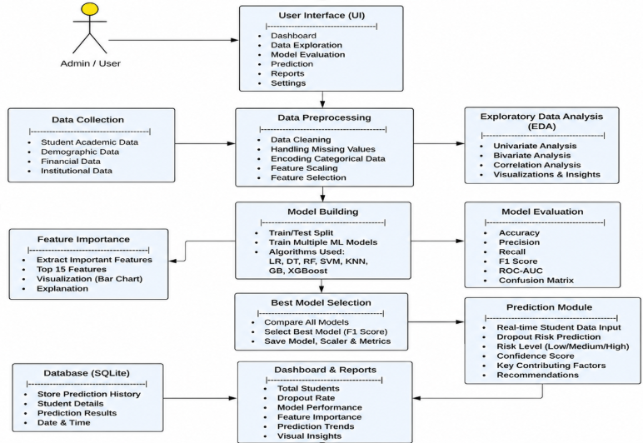
PROPOSED METHOD
Work flow diagram

Slide 6
TECHNOLOGY USED
Frontend: HTML5, CSS3, Bootstrap 5, JavaScript
Backend: Python, Flask
Machine Learning: Scikit-learn, XGBoost
Data Processing: Pandas, NumPy
Visualization: Plotly, Matplotlib
Database: SQLite
Tools: VS Code, Jupyter Notebook, Git & GitHub
Dataset: Kaggle – Student's Dropout and Academic Success Dataset

Slide 7
PROJECT MODULES
User Authentication:
  Secure Admin & User Login with Session Management.
Dataset Management:
  Load, Preprocess, and Validate Student Dataset.
Machine Learning Module:
  Train, Evaluate, and Select the Best ML Model.
Student Risk Prediction:
  Predict Dropout Risk with Confidence Score.
Dashboard & Analytics:
  Display Student Statistics and Interactive Charts.
Recommendation Module:
  Provide Personalized Academic Recommendations.
Prediction History:
  Store, View, and Export Prediction Records.
Web Interface:
  Responsive Flask-Based User Interface.

Slide 8
CONCLUSION
EduShield: AI-Powered Student Retention Analytics Platform provides an effective solution for identifying students who are at risk of dropping out using Machine Learning techniques. By analyzing academic, demographic, and financial data, the system delivers accurate predictions, visual insights, and personalized recommendations. The interactive dashboard and real-time prediction module support educational institutions in making data-driven decisions and implementing timely interventions. Overall, EduShield helps improve student retention, enhances academic success, and demonstrates the practical application of Data Science and Machine Learning in the education sector.

